Slide 1
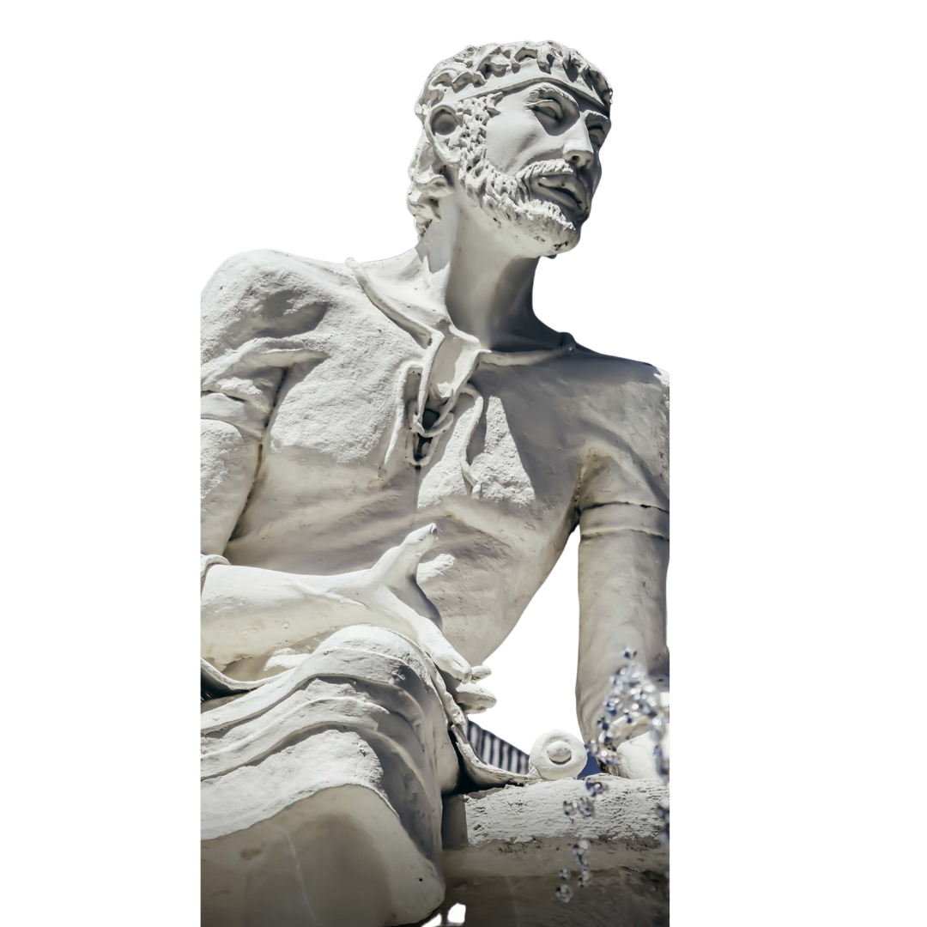
Memorandum of Understanding and Memorandum of Agreement

Slide 2
LOCAL MoUs
Air Seychelles
Central Bank Seychelles (CBS)
Enterprise Seychelles Agency (ESA)
Family Department
Island Biodiversity & Conservation (IBC)
National Assembly Seychelles
Nouvobanq (S.I.M.B.C Ltd)
Seychelles Broadcasting Corporation (SBC)
Seychelles Investment Board (SIB)
Seychelles Institute of Teachers Education (SITE)
Seychelles Island Foundation (SIF)
SilverPearl Tours & Travel
Seychelles National Institute for Culture, Heritage and the Arts (SNICHA)
Seychelles Prison Service (SPS)
Sustainability for Seychelles (S4S) & HSavy Insurance Company Limited (HSI)
Terrestrial Restoration Action Society of Seychelles (TRASS)
The Hilton Seychelles Hotels
The Seychelles Institute of Art & Design (SIAD)
The Seychelles Institute of Agriculture & Horticulture (SIAH)
The Seychelles Police

Slide 3
LOCAL MoAs
Air Seychelles - Barter Agreement
Cable and Wireless Seychelles – Hackathon Agreement
Enterprise Seychelles Agency - SEEDS Capital Agreement
Nouvobanq (S.I.M.B.C Ltd) - Financial Awareness Agreement
Pillay R Group – Staff Welfare Agreement
Seychelles National Institute for Culture, Heritage and the Arts - Folktale database agreement
Seychelles Prison Service - Programme and Research Agreement

Slide 4
INTERNATIONAL University MoUs
Asia Pacific University (Malaysia)
Örebro University (Sweden)
SEGi University and Colleges (Malaysia)
Thomas More University (Belgium)
Service Diocesain de l’Education Catholique (SeDEC) (Mauritius)
University of Bologna (Italy)
L'Universite de la Reunion (Reunion)

Slide 5
INTERNATIONAL University MoAs
Örebro University Agreement (Sweden)
Thomas More University Agreement (Belgium)
University of Mauritius - CISCO Networking Academy Agreement (Mauritius)
University of Mauritius Education Agreement (Mauritius)

Slide 6
Multilateral Agreements
Agence Universitaire Francophonie (AUF)
Commission d’Ocean Indien (COI)
Southern Afican Regional Universities Association (SARUA)
The Association of Commonwealth Universities (ACU)

